Slide 1
ESc201 : Introduction to Electronics
Digital Circuits
Vipul Arora
Dept. of Electrical Engineering
IIT Kanpur
April 6, 2022

Slide 2
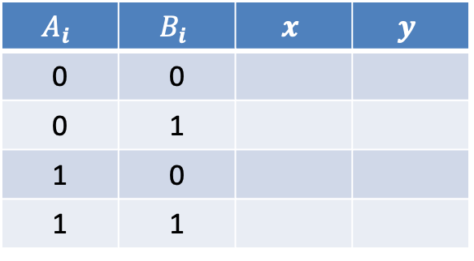
Comparator
$$A_{i}$$ | $$B_{i}$$ | $$x$$ | $$y$$
0 | 0
0 | 1
1 | 0
1 | 1

Slide 3
Comparator
where x_{i} = 1 only if the pair of bits in position i are equal (i.e., if both are 1 or both are: 0).
all x_{i} variable must be equal to 1

Slide 4
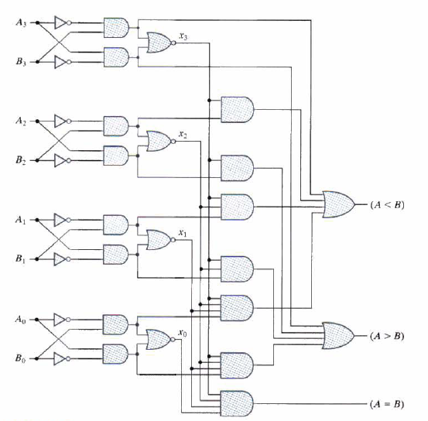

Slide 5
Adder
1
1 1 1
1 1 0
---------
1 1 0 1

Slide 7
4-bit Adder
0
S₃
S₁
S₀
S₂
C₃
C₂
C₁
0
C₄
A₃
B₃
A₂
B₂
A₁
B₁
A₀
B₀
FA = Full Adder

Slide 8
Subtraction
A - B = A + 2’s complement of B
A - B = A + 1’s complement of B+1

Slide 9
Adder/Subtractor
0

